Slide 1
PYTHON MINI PROJECT- WEATHER PREDICTION
-ASHWATI RAO (18IT2018)
-SAGAR NIRMAL (18IT1095)
-SAHIL SATAV (18IT1007)

Slide 2
FEATURES
Weather forecasting is the application of science and technology to predict the conditions of the atmosphere for a given location and time.
One can easily find out the weather of different cities by typing the name of that city.
It can also give information about temperature as well as atmospheric conditions of a city.

Slide 3
IDES AND FRAMEWORKS USED
Backend: Python, Django framework
Frontend: Bulma CSS, HTML
API Key
Sublime Text
Git Bash

Slide 4
STATUS OF THE PROJECT
The project is successfully completed.
User can easily check the weather of different cities.
User can add as many cities as he wants in the city list.

Slide 5
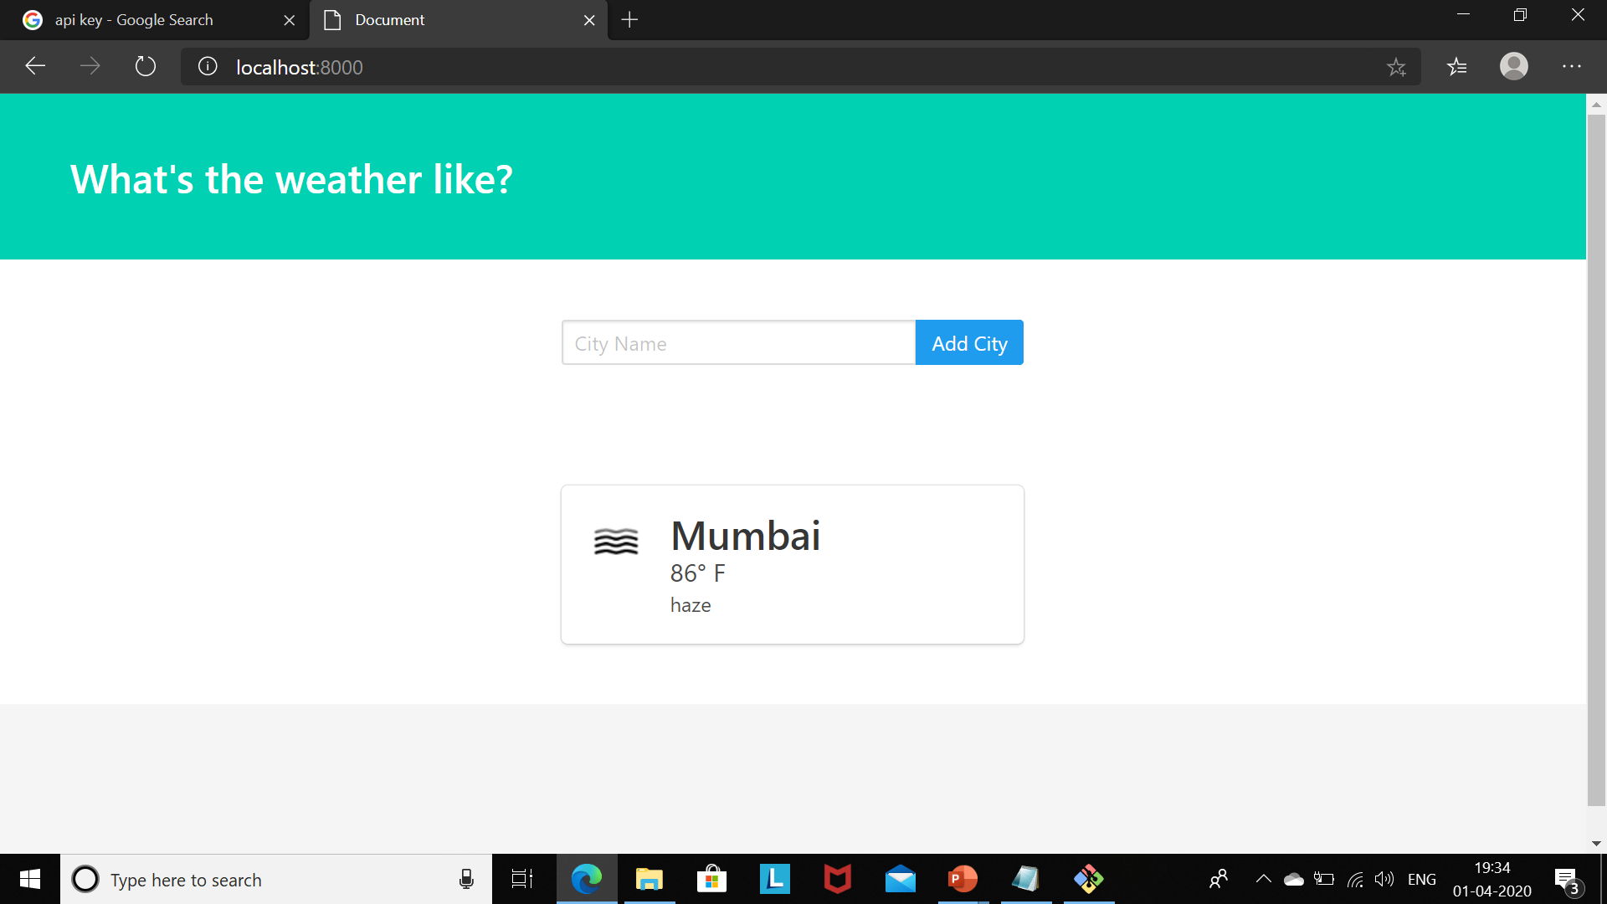

Slide 6

THANK YOU!

